Slide 1
EDA Project
T5004
Abdulaziz Alshehri

Slide 2
Exploratory Data Analysis (EDA) Project
What patterns people follows in the NYC subway?
Relationship between the NYC subway and taxies?

Slide 3
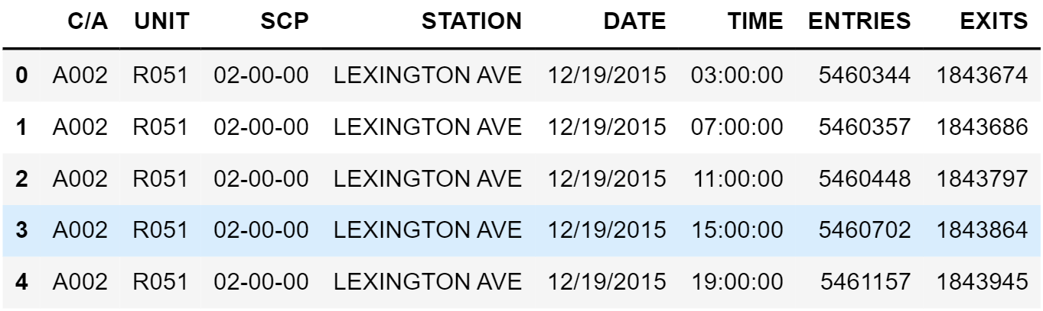
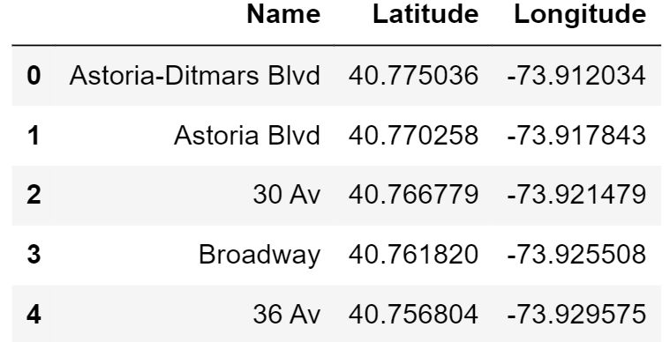
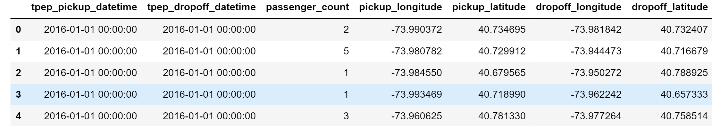


DATASETS
MTA
Station Name (common column)
STATIONS
TAXIES

Slide 4

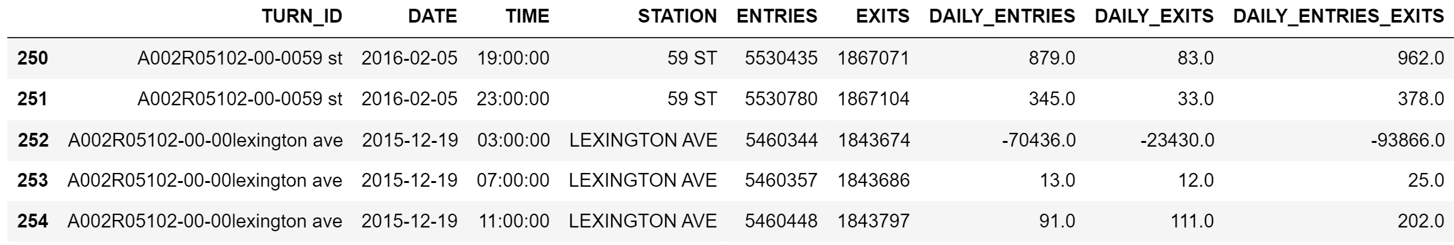
CLEANING MTA – Wrong Data
Wrong Subtraction between two different turnstiles

Slide 5
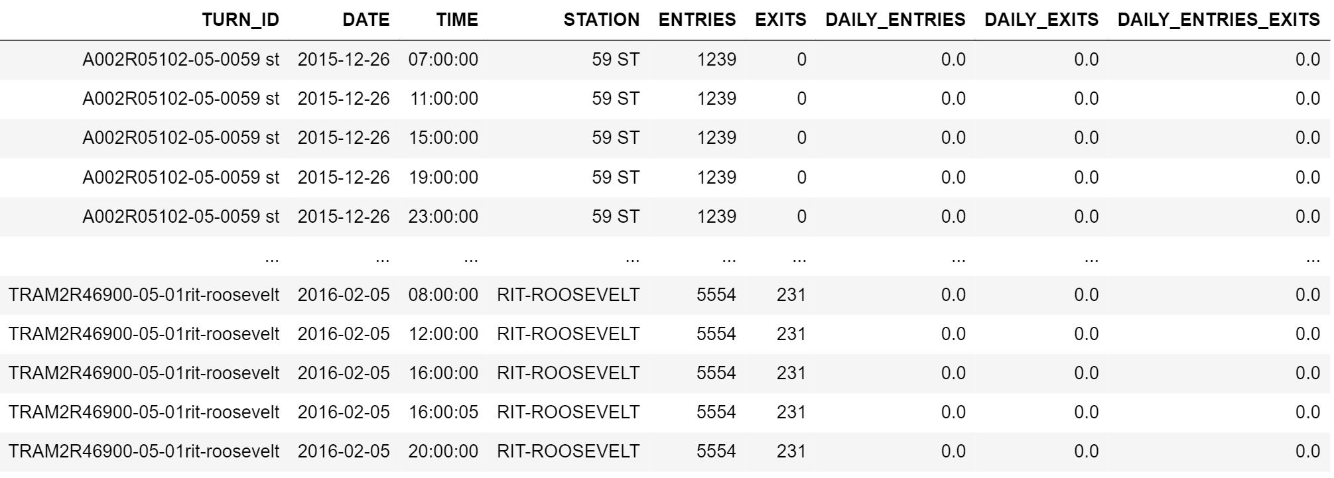
CLEANING MTA – Off-Duty Turnstiles
Turnstiles values not changing

Slide 6
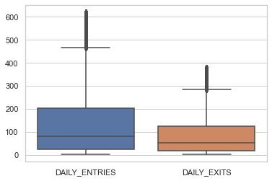
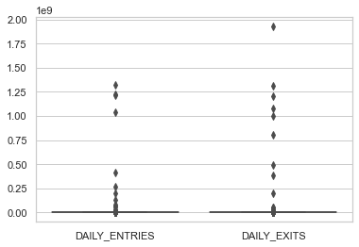


CLEANING MTA - Outliers
Before removing outliers
After removing outliers

Slide 7
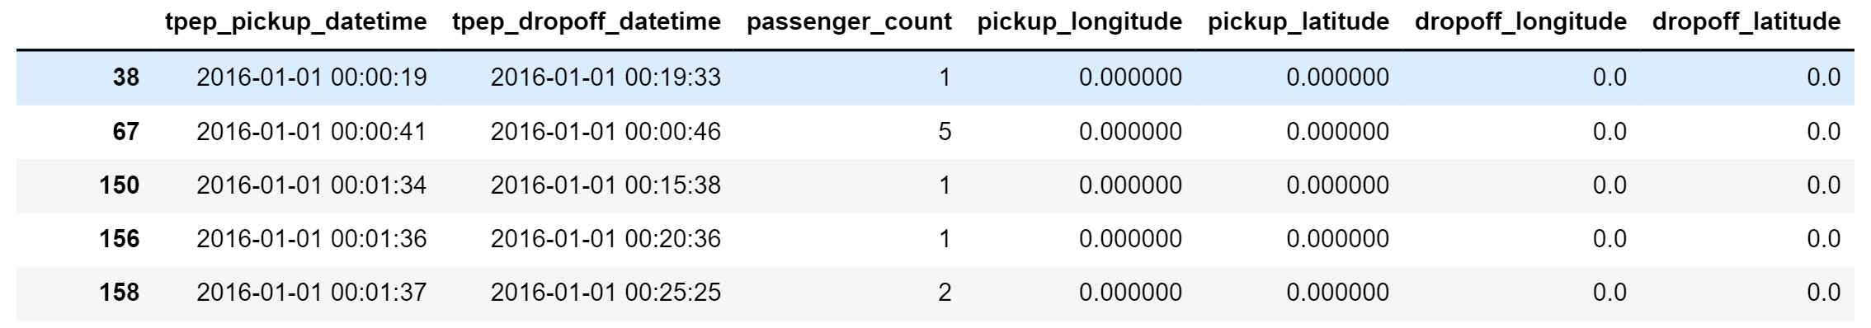

CLEANING TAXI – Zeros and Duplicates
zeros coordinates
duplicate rows

Slide 8
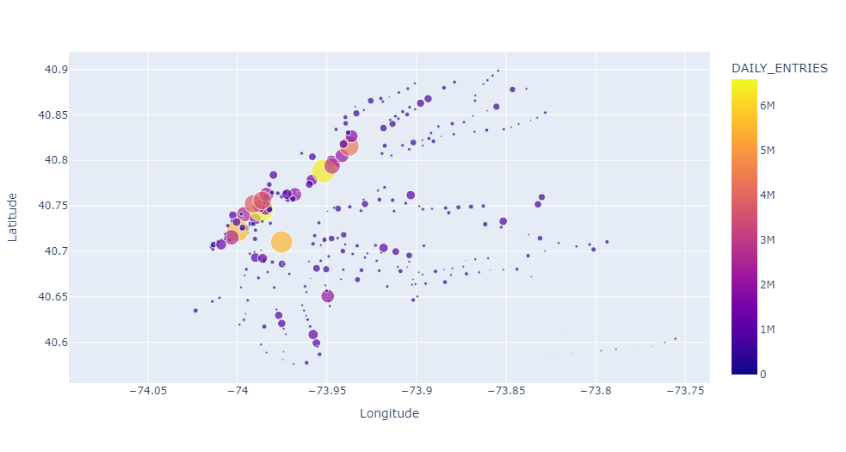
RESULTS - daily_entries

Slide 9
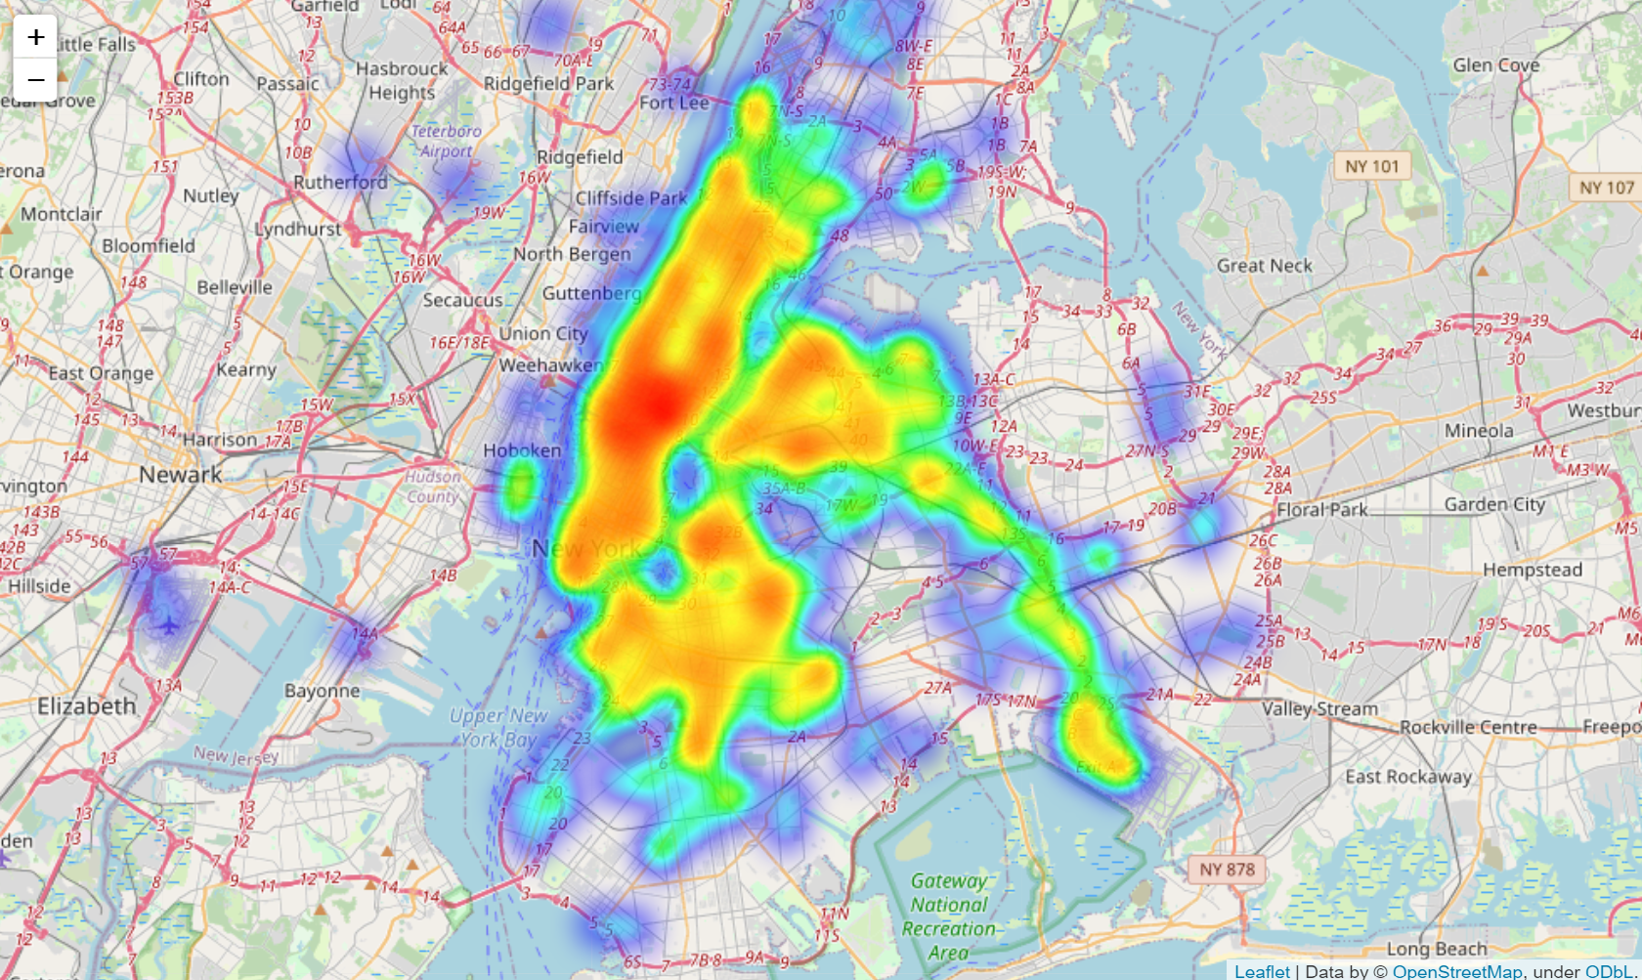
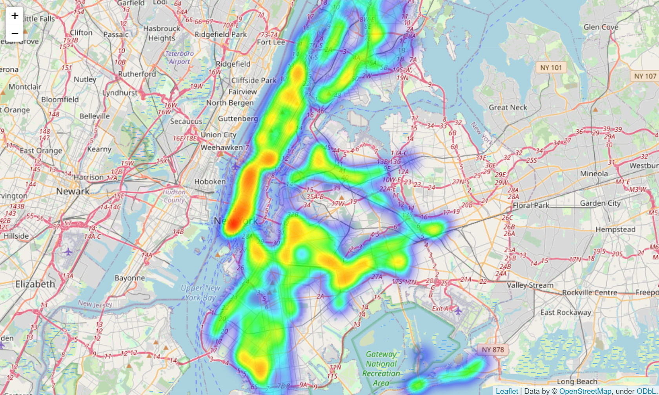
RESULTS – Taxi vs Subway Heatmap
subway entries heatmap
taxi pickups heatmap

Slide 10
CONCLUSIONS
MTA and Stations datasets joined to get stations locations.
Stations dataset didn’t require any cleaning.
Plotting stations their entries show that Manhattan is the busiest.

Slide 11
RECOMENDATIONS
Based on our analysis we recommend for Taxi & Limousine Commission to direct taxis’ drivers to more crowded stations (e.g., times sq 42 ST, etc.).

Slide 12
FURTHER WORK
This analysis can be enhanced in many ways e.g. extending the exploratory of relationship between taxies and subway demand.

